Slide 1
L5_Projection of Point
B. SANTHI
Assistant t Professor
Department of MECHANICAL Engineering
NIT Goa

Slide 2
Orthographic projection of points in Space
Point
Represents a location in space
Dimensionless geometrical entity which has simply position
but no magnitude
Obtained at the intersection of three mutually perpendicular planes.
Usually represented by a dot or a very small circle
Projections of points have no practical significance, but it serves as
the basis for projections of lines, projections planes and projections of solids
In conventional coordinate system position of point in space is denoted by
its three coordinates viz. x,y, z. but in engineering drawing
two reference planes (HP-Horizontal plane and VP- Vertical Plane) are used
to indicate position of points in space

Slide 3
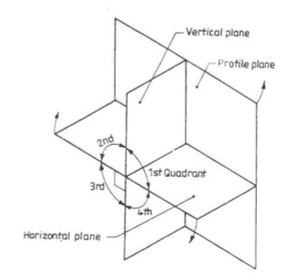
Orthographic projection of points in Space
A point may lie in space in anyone of the four quadrants formed by two principal planes of projection or may lie on any one of them or both of them
The positions of a point are:
First quadrant
when it lies above H.P and in front of V.P
2. Second quadrant
when it lies above HP and behind V.P
3. Third quadrant
when it lies below H.P and behind V.P
4. Fourth quadrant
when it lies below H.P and in front of V.P
Projection on H.P => Top view
and Projection on V.P => Front view

Slide 4
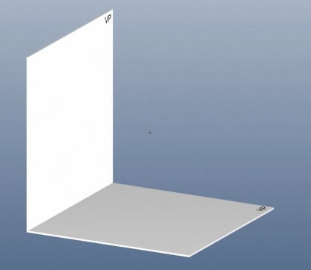
Orthographic projection of points situated in 1st quadrant
The positions of a point are:
First quadrant
when it lies above H.P and in front of V.P
Projection on H.P => Top view
Projection on V.P => Front view

Slide 5
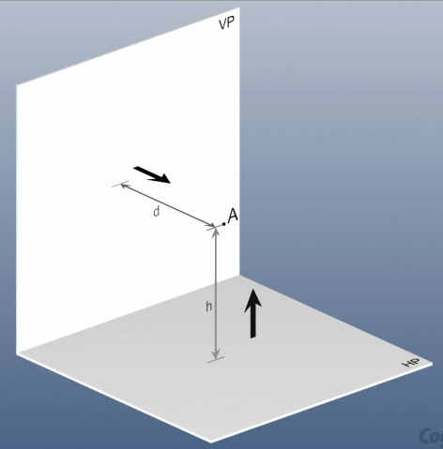
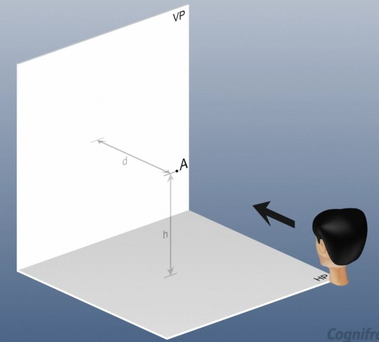
Orthographic projection of points situated in 1st quadrant
Representation of a point
h = Height above or below HP
d = Distance before or behind VP

Slide 6
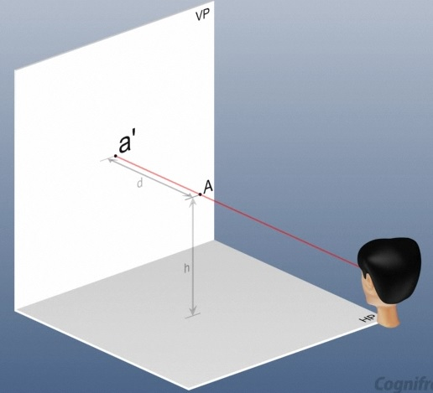
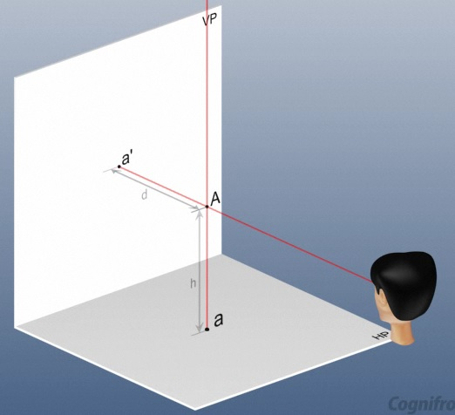
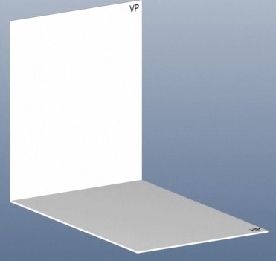

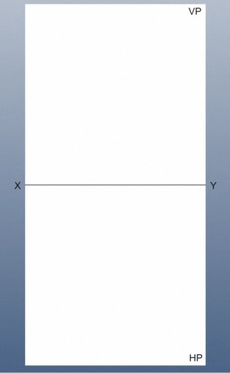
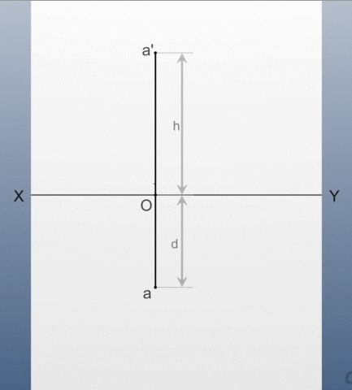
Orthographic projection of points situated in 1st quadrant

Slide 7
Orthographic projection of points situated in 1st quadrant
Notation to be followed
Actual points in space are denoted by capital letters A, B, C
Their front views are denoted by their corresponding
lower case letters with dashes a’, b’, d’ etc., and
their top views by the lower case letters a, b, c etc.
3. Projectors are always drawn as continuous thin lines

Slide 8
Orthographic projection of points situated in 1st quadrant
Front view - a’ is above xy line
Top view – a is below xy line
oa’ = aA= distance of front view from xy = distance of A from the H.P
oa= a’A= distance of top view from xy line= distance of A from the V.P

Slide 9
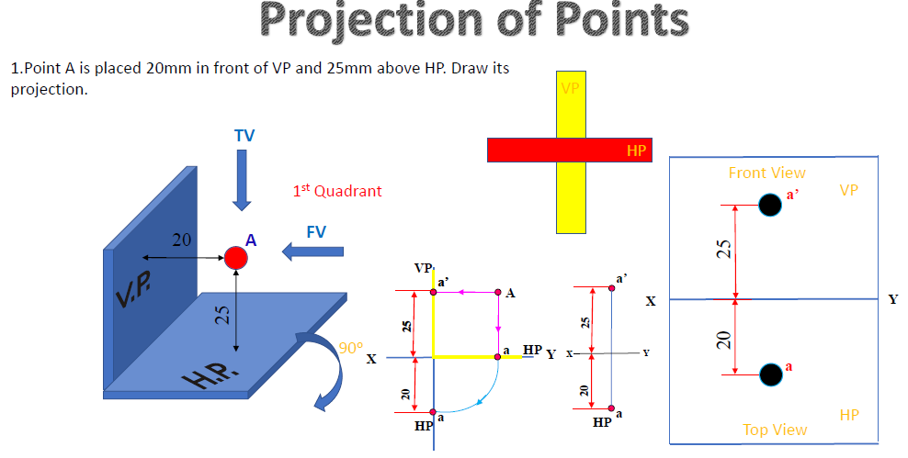

Slide 11
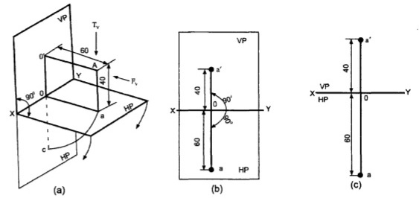
Orthographic projection of points situated in 1st quadrant
Qn : Point A is 40 mm above HP and 60 mm in front of V.P.
Draw its front and top view
The point A lies in the 1st Quadrant
Looking from the front, the point lies 40 mm above H.P. A-a’ is the projector perpendicular to V.P. Hence a’ is the front view of the point A => 40 mm above the xy line
To obtain the top view of A, look from the top. Point A is 60mm in front of V.P. Aa is the projector perpendicular to H.P. So, a is the top view of the point A => 60 mm in front of xy.

Slide 12
Point A is 40 mm above HP and 60 mm in front of V.P. Draw the Projection of points in VP and HP
Steps
Draw Ref line xy
From any point on xy line , draw a perpendicular line and mark a’ 40mm above and a 60 mm below the ref line
Draw the projector line joining a’ and a and dimension the views

Slide 13
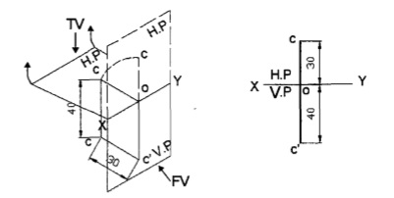
Orthographic projection of points situated in 3rd quadrant
A point C is 40 mm below HP and 30 mm behind V.P. Draw its projection.
The point C is in the 3rd Quadrant
C is 40 mm below H.P Hence c’ is 40 mm below xy.
Draw xy and draw projector at any point on it. Mark c’ 40 mm below xy on the projector.
C is 30 mm behind V.P. So c is 30 mm behind xy. Hence in the orthographic projections mark c 30 mm above xy on the above projector.

Slide 14
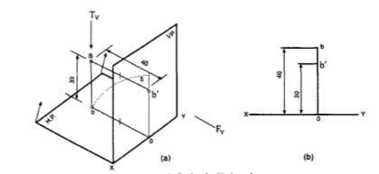
Example: projection of point in 2nd quadrant
A Point B is 30 mm above HP and 40 mm behind V.P Draw its projection.
The point B lies in the II Quadrant.
It is 30 mm above H.P and b’ is the front view of B and is 30 mm above xy.
Point B is 40 mm behind V.P. and b is the top view of B which is 40 mm behind xy.
To obtain the orthographic projections from the pictorial view rotate H.P by 90° about xy. Now the H.P coincides with V.P. and both the front view and top view are now seen above xy. b on the H.P will trace a quadrant of a circle with o as center and ob as radius. Now b occupies the position above o.
To draw the orthographic projections; draw xy line on which a projector is drawn at any point. Mark on it b’ 30 mm above xy on this projector.
Mark b 40 mm above xy on the same projector.

Slide 15
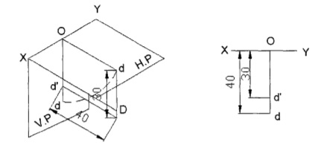
Orthographic projection of points situated in 4th quadrant
A point D is 30 mm below HP and 40 mm in front of V.P. Draw its projection.
The point D is in the IV Quadrant.
D is 30mm below H.P. Hence, d’ , is 30 mm below xy. Draw xy line and draw a projector perpendicular to it. Mark d’ 30 mm below xy on the projector.
D is 40mm in front of V.P; so d 40 mm in front of xy. Therefore, mark d 40 mm below xy.

Slide 16
Side view of a point
Point A is 30mm above HP, 50 mm in front of V.P. and 40 mm in front of Right PP.
Draw its projection.
Step 1
•
•
a'
a'
50
50
X
Y
X
Y
30
30
•
•
a
a

Slide 17
Point A is 30mm above HP, 50 mm in front of V.P. and 40 mm in front of Right PP.
Draw its projection.
.
Step 2
•
X’
•
a'
a'
50
50
X
Y
X
Y
30
30
•
•
a
a
Y’

Slide 18
Point A is 30mm above HP, 50 mm in front of V.P. and 40 mm in front of Right PP.
Draw its projection.
Step 3
•
X’
•
a'
a'
50
50
X
Y
X
Y
30
30
•
•
a
a
Y’

Slide 19
Point A is 30 mm above HP, 50 mm in front of V.P. and 40 mm in front of Right PP.
Draw its projection.
Step 4
a'
X’
•
•
a'
50
50
X
Y
X
Y
30
30
•
•
a
a
Y’

Slide 20
Point A is 30mm above HP, 50 mm in front of V.P. and 40 mm in front of Right PP.
Draw its projection.
Step 5
a'
X’
•
•
a'
50
50
X
Y
X
Y
30
30
•
•
a
a
Y’

Slide 21
Point A is 30mm above HP, 50 mm in front of V.P. and 40 mm in front of Right PP.
Draw its projection.
Step 6
a'
X’
•
•
a'
50
50
X
Y
X
Y
30
30
•
•
a
a
Y’

Slide 22
Point A is 30mm above HP, 50 mm in front of V.P. and 40 mm in front of Right PP.
Draw its projection.
Step 7
X’
a'
•
•
a'
•
a”
50
50
X
Y
X
Y
30
30
•
•
a
a
Y’
Instead Arc OY, an inclined line of 45 degree
can also be used to get projection of point in side view

Slide 23
Thank You

